Slide 1
Front End Engineering
Project - 1
Team Details:
Dhruv Bansal(2210990271)
Dhruv Datta(2210990272)
Dhruv Garg(2210990273)
Dhruv Grover(2210990274)
Faculty Coordinator:
Dr. Monika Sethi
Chitkara University Institute of Engineering and Technology,
Chitkara University, Punjab

Slide 2
Contents
Introduction
Problem Statement
Technical Details
Key Features
Project Highlights
Conclusion
References/Links used

Slide 3
Introduction
"Note log" can refer to a few different things depending on the context, but generally, it refers to a record or collection of notes.
In the context of software or computer applications, a note log may refer to a feature that allows users to keep track of changes or updates made to a document, project, or system. For example, in a programming environment, a note log could track changes made to the codebase, helping developers keep track of modifications and understand how the code has evolved over time.
In a personal or academic context, a note log may refer to a system or method of taking and organizing notes. This could be a physical notebook or a digital note-taking app that allows users to capture and organize their thoughts, ideas, and information.
Overall, a note log is a tool or system designed to help users keep track of information, whether that be changes to a document or personal notes and ideas.
:

Slide 4
Problem Statement
The problem with note logs is that they can quickly become disorganized and difficult to manage. As users add more notes or make changes to existing ones, the information can become scattered or lost, making it challenging to find what is needed when it is needed.
Additionally, note logs can be challenging to maintain consistently, as users may not have a clear system for organizing their notes or may not have the time to regularly review and update their log.
Another problem with note logs is that they may not be easily shareable or accessible by others, especially if they are kept in a physical notebook or on a personal computer that is not accessible to others.
Finally, note logs can also become a source of information overload, with users struggling to sift through a large volume of notes to find the specific information they need.
Overall, the problem with note logs is that they can quickly become overwhelming and difficult to manage, making it challenging to effectively organize and retrieve information.

Slide 5


Technical Details
We used HTML and CSS to design the Note Log. We also used Visual Code Studio to write the codes.

Slide 6
Key Features
•To-Do-List: You can use it as a to do list and enter your things that you need to do..
•Date Time Feature: Date and Time automatically gets tagged with the Notes Created.
•Delete Feature: Help to delete notes.
•NAV Bar: Contains a nav bar that helps to access different contents of the website easily.

Slide 7
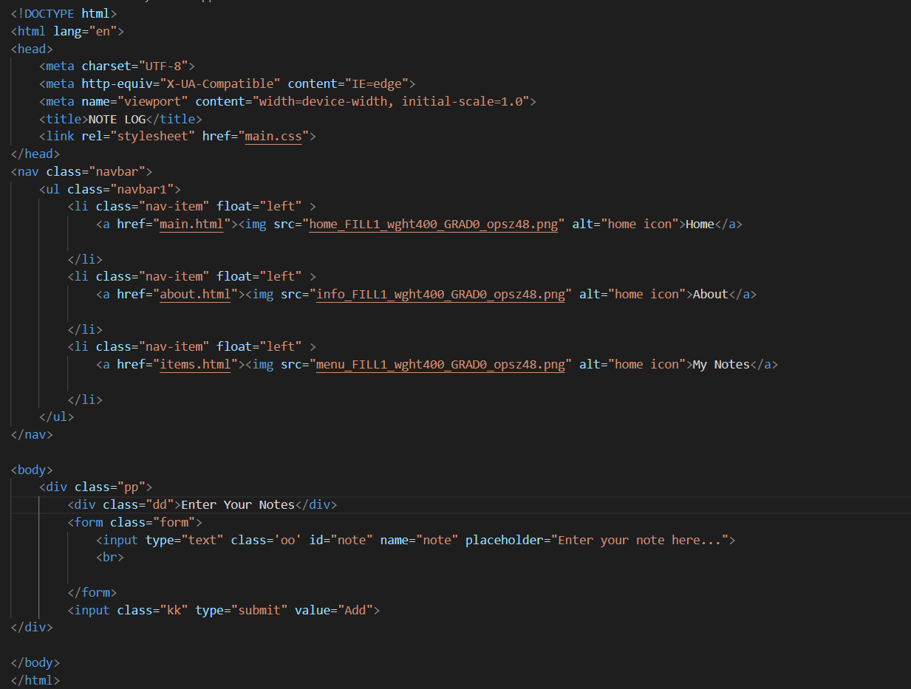
Project Highlights 1
HTML CODE SNIPPETS (Home):

Slide 8
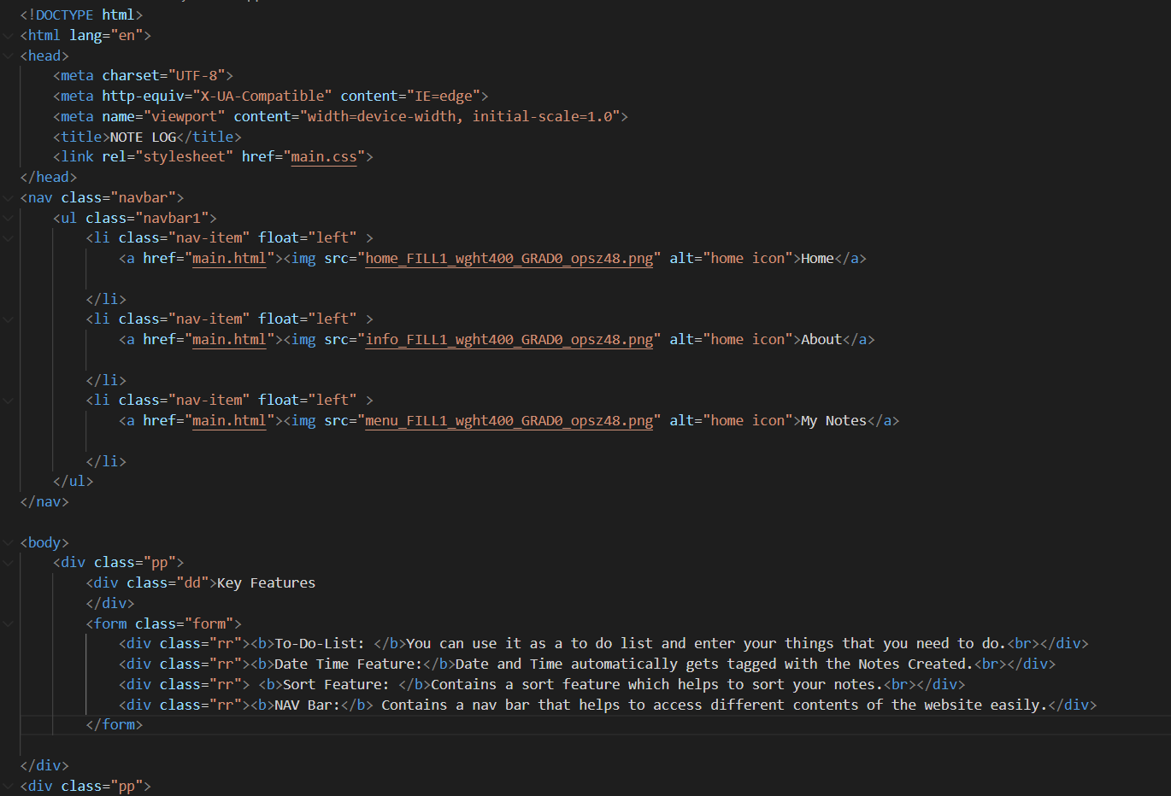
Project Highlights 1
HTML CODE SNIPPETS (About(1)):

Slide 9
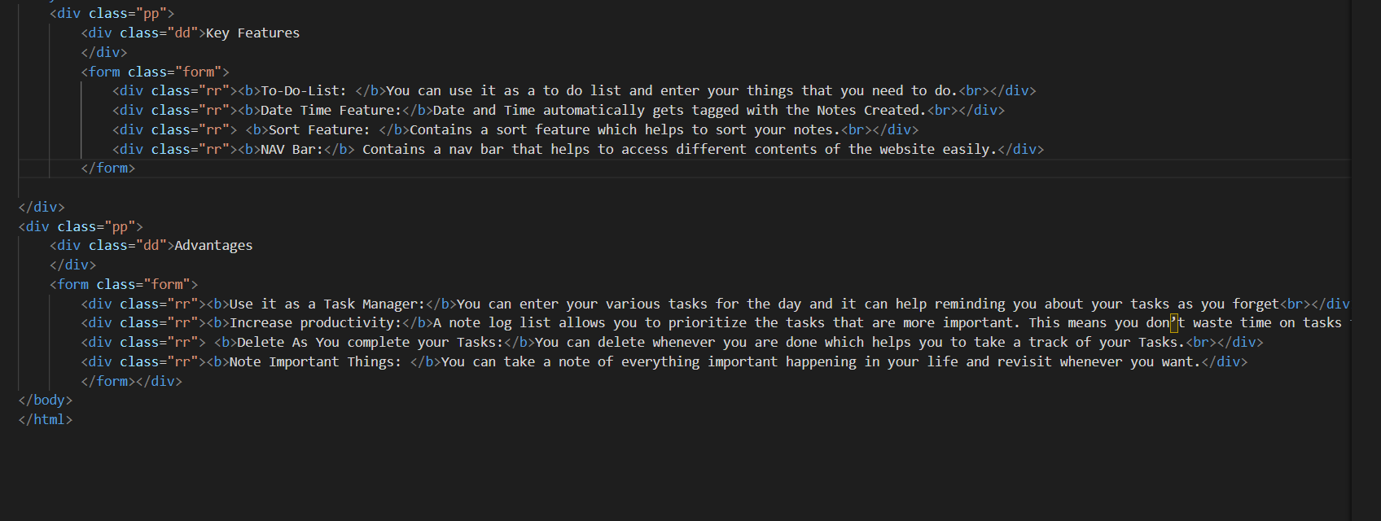
Project Highlights 1
HTML CODE SNIPPETS (About(2)):

Slide 10
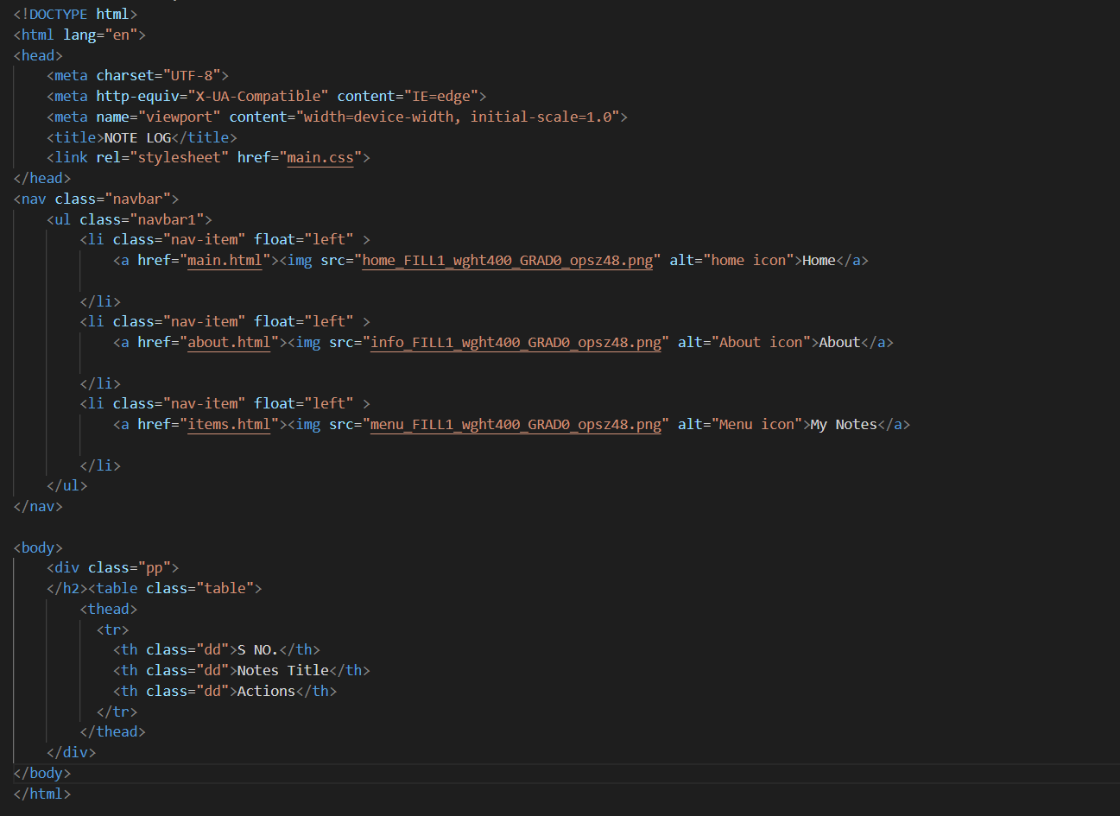
Project Highlights 1
HTML CODE SNIPPETS (Items):

Slide 11
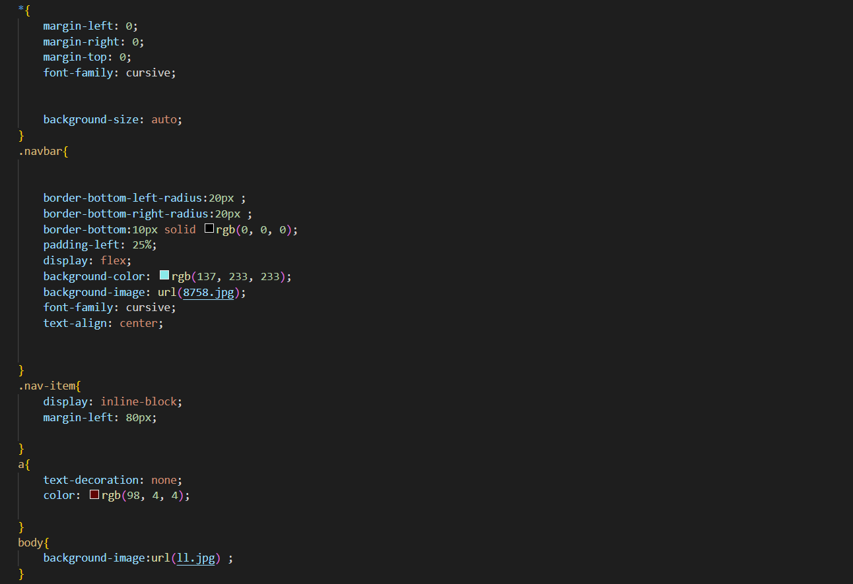
Project Highlights 2
CSS CODE SNIPPETS(1):

Slide 12
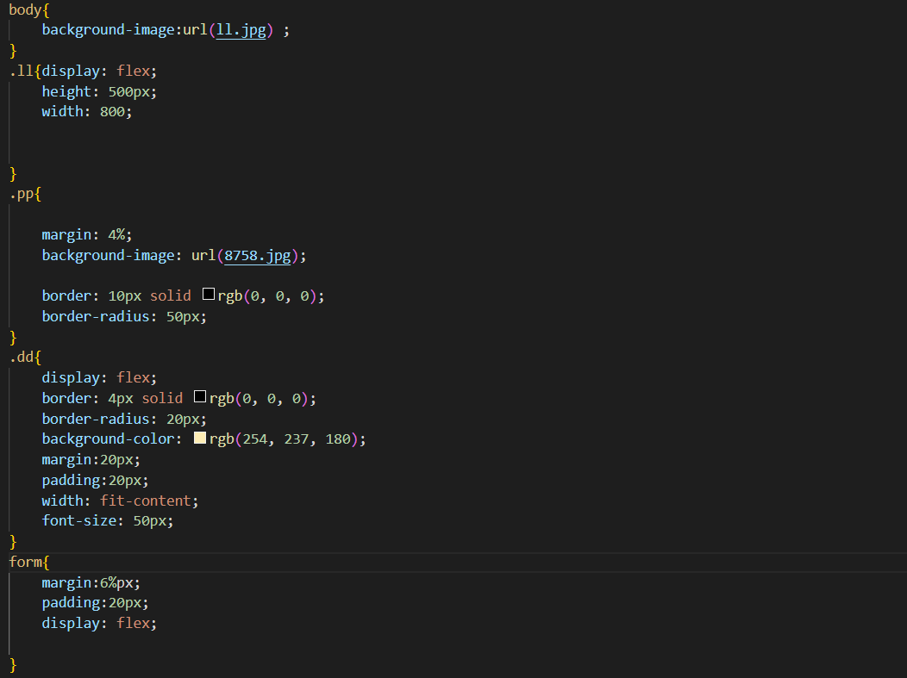
Project Highlights 2
CSS CODE SNIPPETS(2):

Slide 13
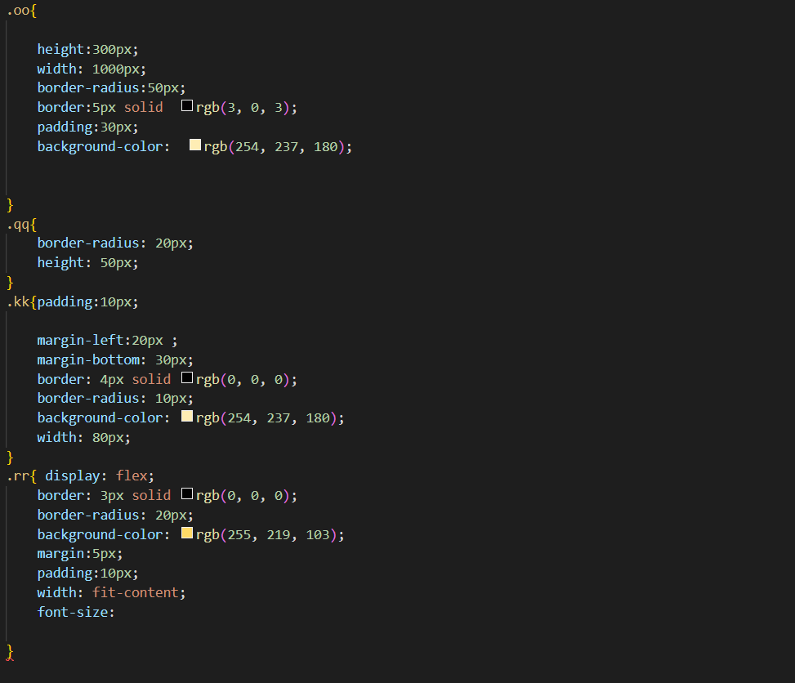
Project Highlights 2
CSS CODE SNIPPETS(3):

Slide 14
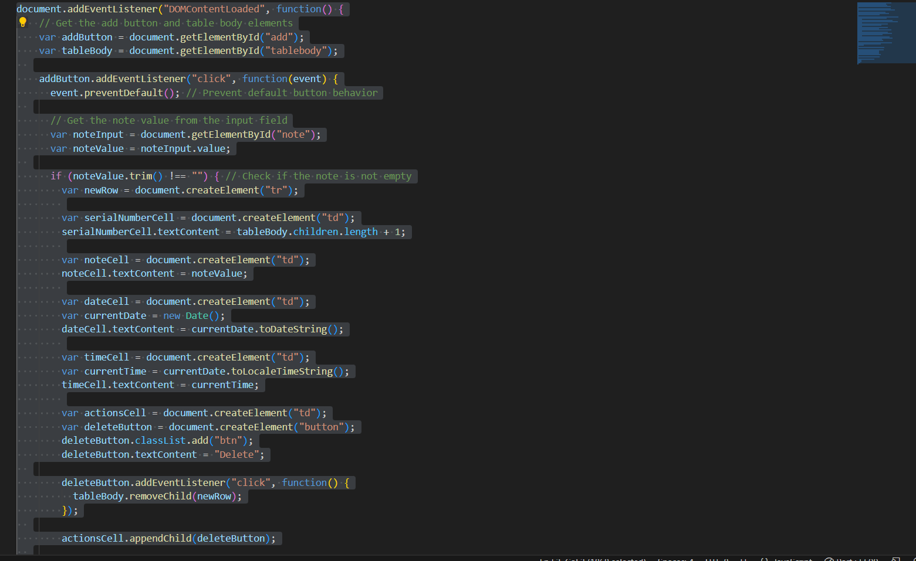
Project Highlights 3
Javascript code snippets:

Slide 15
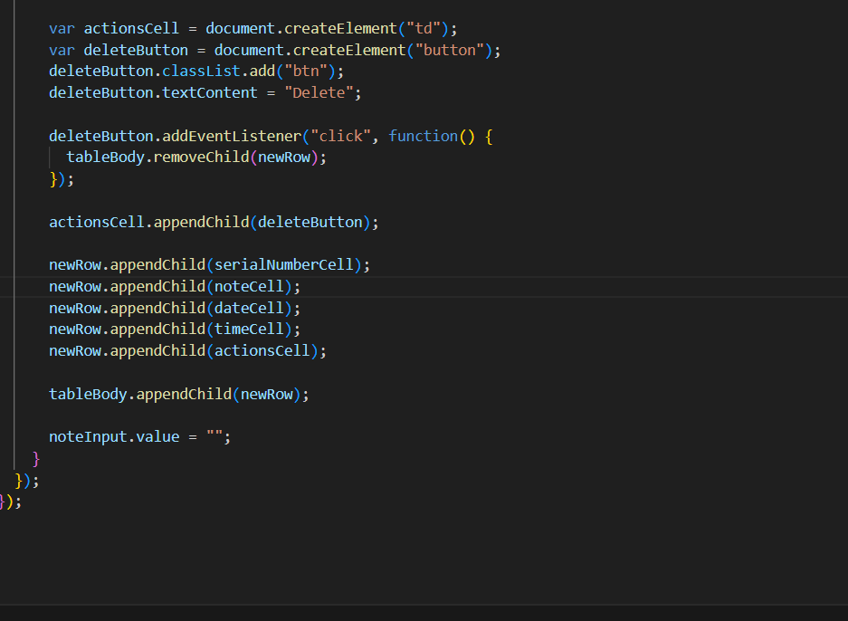
Project Highlights 3
Javascript code snippets:

Slide 16
Conclusion
Note log is an essential part of our lives to maintain short and precise record of data in everyday lives.
If note log is done correctly it will help immensely.

Slide 17
References/Links used
WIKIPEDIA- https://www.wikipedia.org/
W3SCHOOLS-https://www.w3schools.com/

Slide 18
Thank You

